Slide 1

ELEC0138 Security & Privacy
Coursework 1
Threat Models
By Group Q
Members:
Kailai Lin Huanxi Tong
Junyu Zhu Ruowei Xing

Slide 2

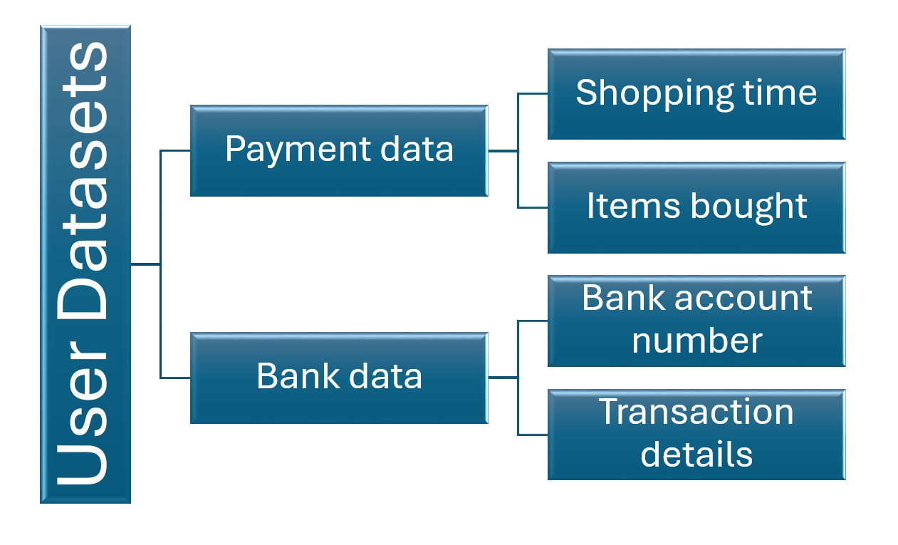
01
Assets Identification
User Datasets

Slide 3


Assets Identification
infrastucture
Database
With security applications
2
1
3
Terminal devices
& other IoT instantiations
Data processing
With distributed learning,
Privacy protection, etc.

Slide 4

02
Threat Models:
Malicious attacks
Vulnera-bilities:
Possible Protection
Likelihood:
Impact:
Loss of service /poisoned data / model,
leading to the loss of critical functions, sensitive info. exposure,
leading to degraded reputation.
Network isolation, application-layer threat prevention, identity and access management (IAM), regular security updates.
Exploiting vulnerabilities in the database access service.
Low, but significant impact if successful

Slide 5
02
Threat Models:
Employees Misperformance
Vulnera-bilities:
Possible Protection
Likelihood:
Impact:
Utilize Role-Based Access Control (RBAC), enforce the Least Privilege Principle, and employ data encryption to restrict unauthorized access.
Internal database access service vulnerabilities
Relatively Low
Loss of service or leakage of sensitive data, enabling external attacks

Slide 6
02
Threat Models:
PII-contained data exposure during network transporting
Vulnera-bilities:
Possible Protection
Likelihood:
Impact:
network transportation & encryption vulnerabilities
Moderate
Partial but sensitive data breaches, financial loss, reputational damage
Robust encryption algorithms,
intrusion detection systems (IDS), stringent access control mechanisms

Slide 7
03
Data Sources and Attacks Set-Up
To assess and simulate potential attacks, various data sources including network traffic logs, system logs, application logs, and data flow diagrams could be considered.
Data could be accessed via online databases (Kaggle etc.) or simulated if possible (de-private);

Slide 8
03
Data Sources and Attacks Set-Up
Set up a Linux VM for testing & performing attacks, reusing code snippets given in lectures.
-tcpreplay, pcap(s), python files (for later processing)
Possible attacks as listed:
Ddos (tcp,dos, http…)
Man-in-the-middle
Brute-Force (password leakage)

Slide 9
Thanks for watching
By Group Q
Members:
Kailai Lin Huanxi Tong
Junyu Zhu Ruowei Xing
13/Mar/24

